Slide 1
Hip Injuries in Athletes
Focus on Femoroacetabular Impingement (FAI)
Ian Rice MD
Sports Medicine Orthopedic Surgeon
TriHealth Orthopedic and Sports Institute

Slide 2
Overview of Femoroacetabular Impingement (FAI) and related hip conditions
Pathoanatomy
Clinical Diagnosis
Diagnostic Imaging
Hip Arthroscopy Basics
Evidence-Based Medicine for Hip Arthroscopy
Prevention
Take-Away Points

Slide 3
Pathoanatomy

Slide 4
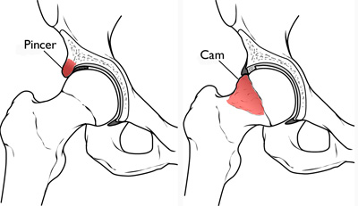
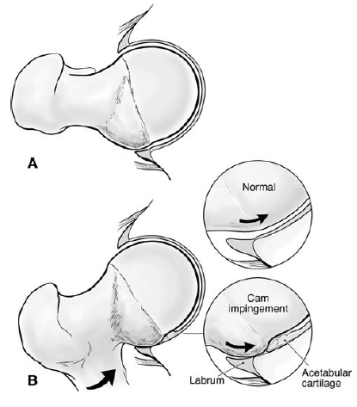
Impingement with hip flexion
Shear forces on cartilage at chondrolabral junction
Subtle findings on MRI:
marcaine arthrogram with traction, 1.5+ T MRI

Slide 5
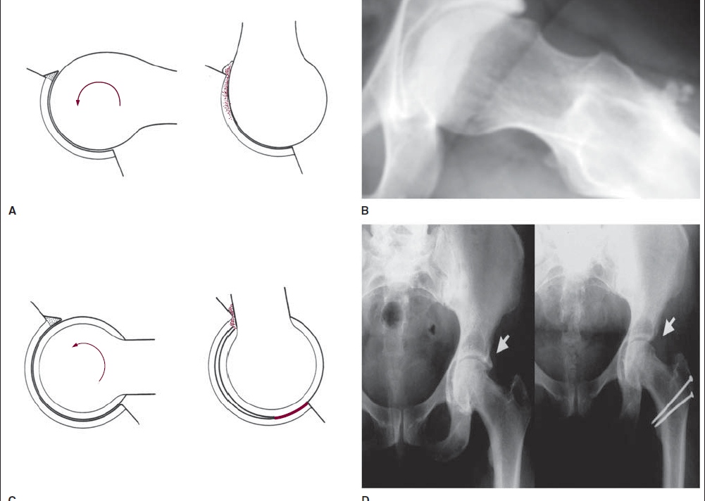
CAM
PINCER

Slide 6
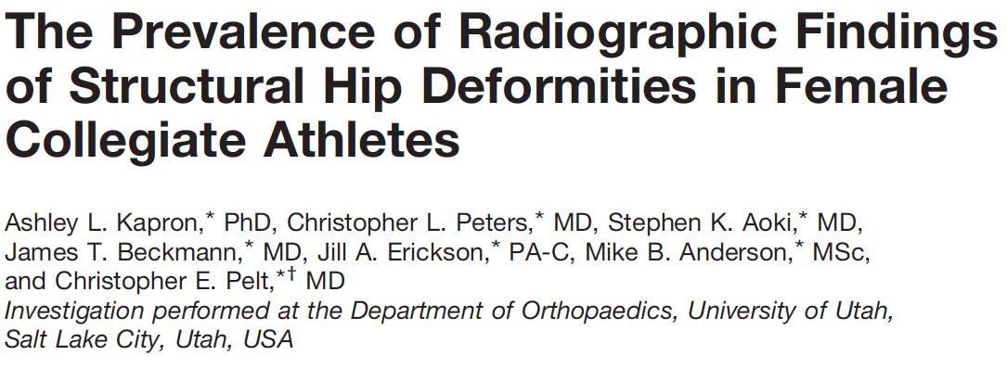
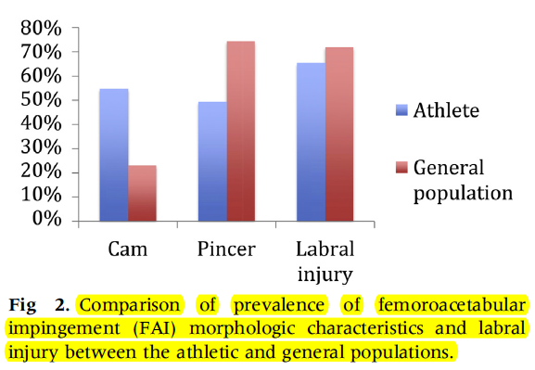
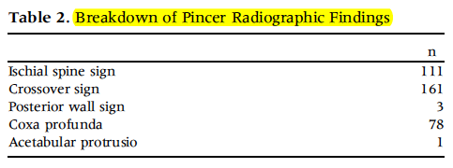
Prevalence/Incidence
37% Asymptomatic CAM Deformity
54% in athletes compared to 23% in normal population
67% Asymptomatic Pincer Deformity
94% NFL combine athletes with previous history groin/hip pain
Overall 10-fold increase risk of alpha angle >55 deg in athletes vs normal population!

Slide 7
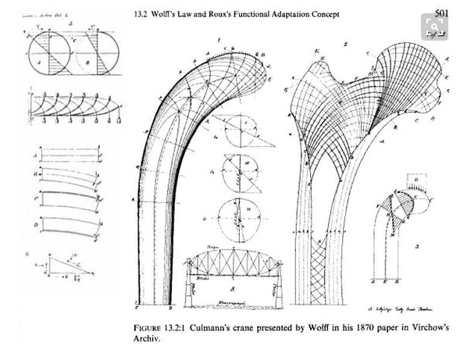
Wolff’s law: Bone will adapt to the loads placed on it

Slide 8
Examination/Clinical Diagnosis

Slide 9
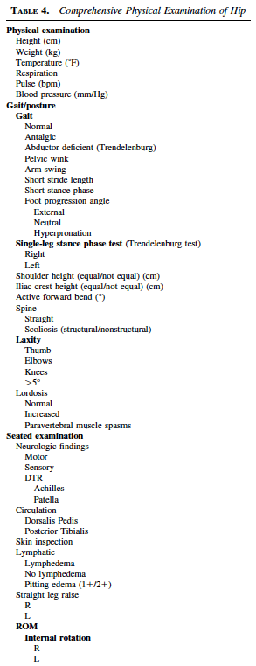
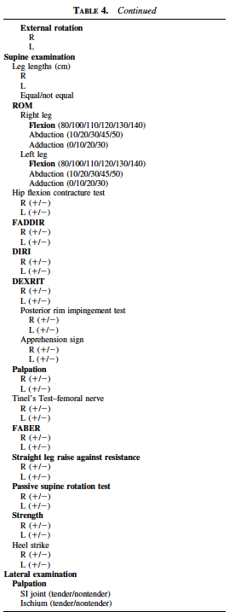
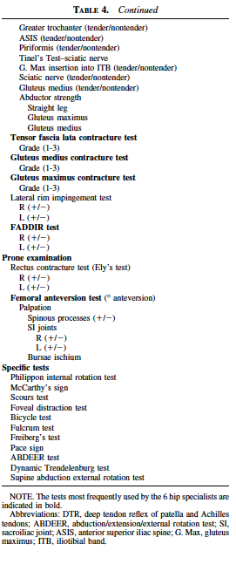
Unrealistic

Slide 10
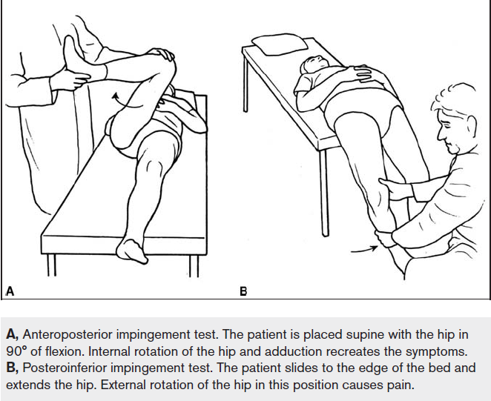
Focus on this Rule Out Other Causes
Have patient sit up and palpate anterior groin/inguinal canal
Sig pain suggestive of sports hernia or peritoneal causes
Test resisted adduction
Adductor (groin) muscle strain or tear
Also palpate adductor origination at pubis
LE Neuro Exam, Straight leg raise
Radiculopathy, referred lumbar spondylosis pain
FADDIR

Slide 11
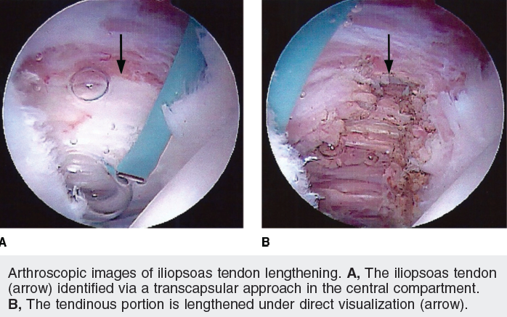
Coxa Saltans
External
Snapping IT Band
Most common
Flexion → Extension or rotation
Internal
Iliopsoas snaps on femoral head or iliopectineal eminence
May be associated with FAI
Also associated with Iliac Spine avulsion injuries and malunion

Slide 12
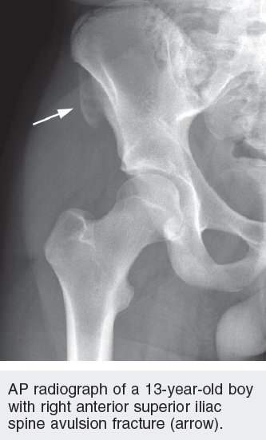
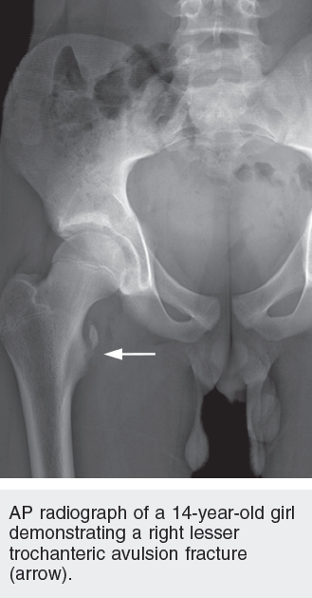
Apophyseal Avulsions
Iliopsoas avulsions from ASIS (origin) or lesser trochanter (insertion)
Rectus Femoris avulsions from AIIS
Hamstring avulsions from ischial tuberosity
Adductor avulsions from pubic rami
“Post-traumatic” FAI = Subspine Impingement

Slide 13
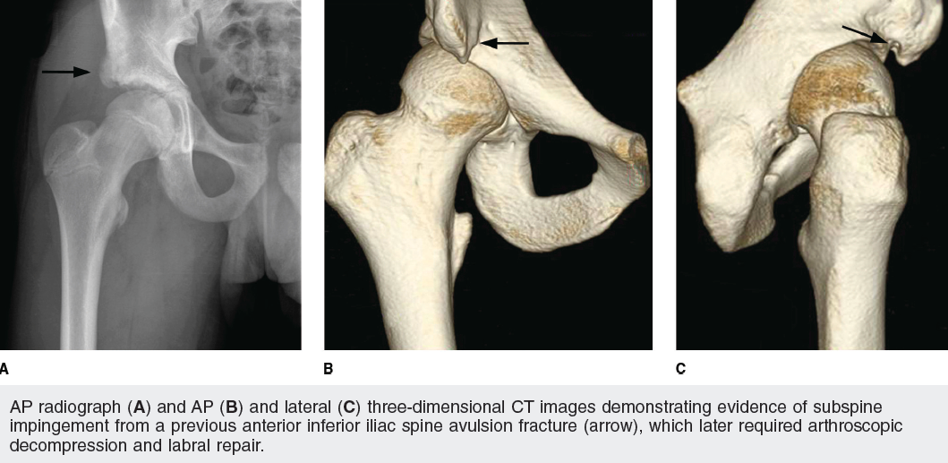

Slide 14
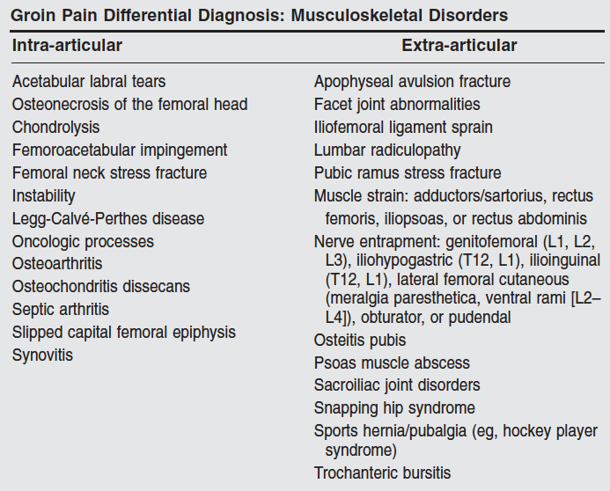
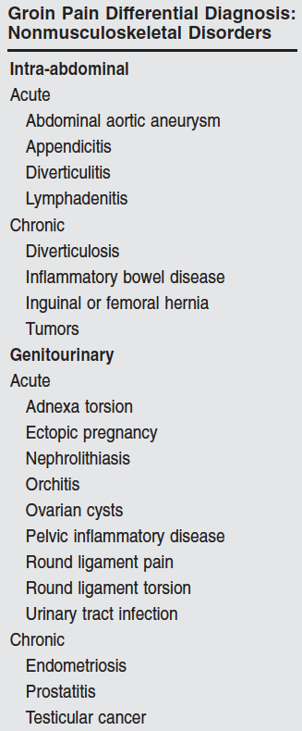

Slide 15
Radiographic Indicators of FAI

Slide 16
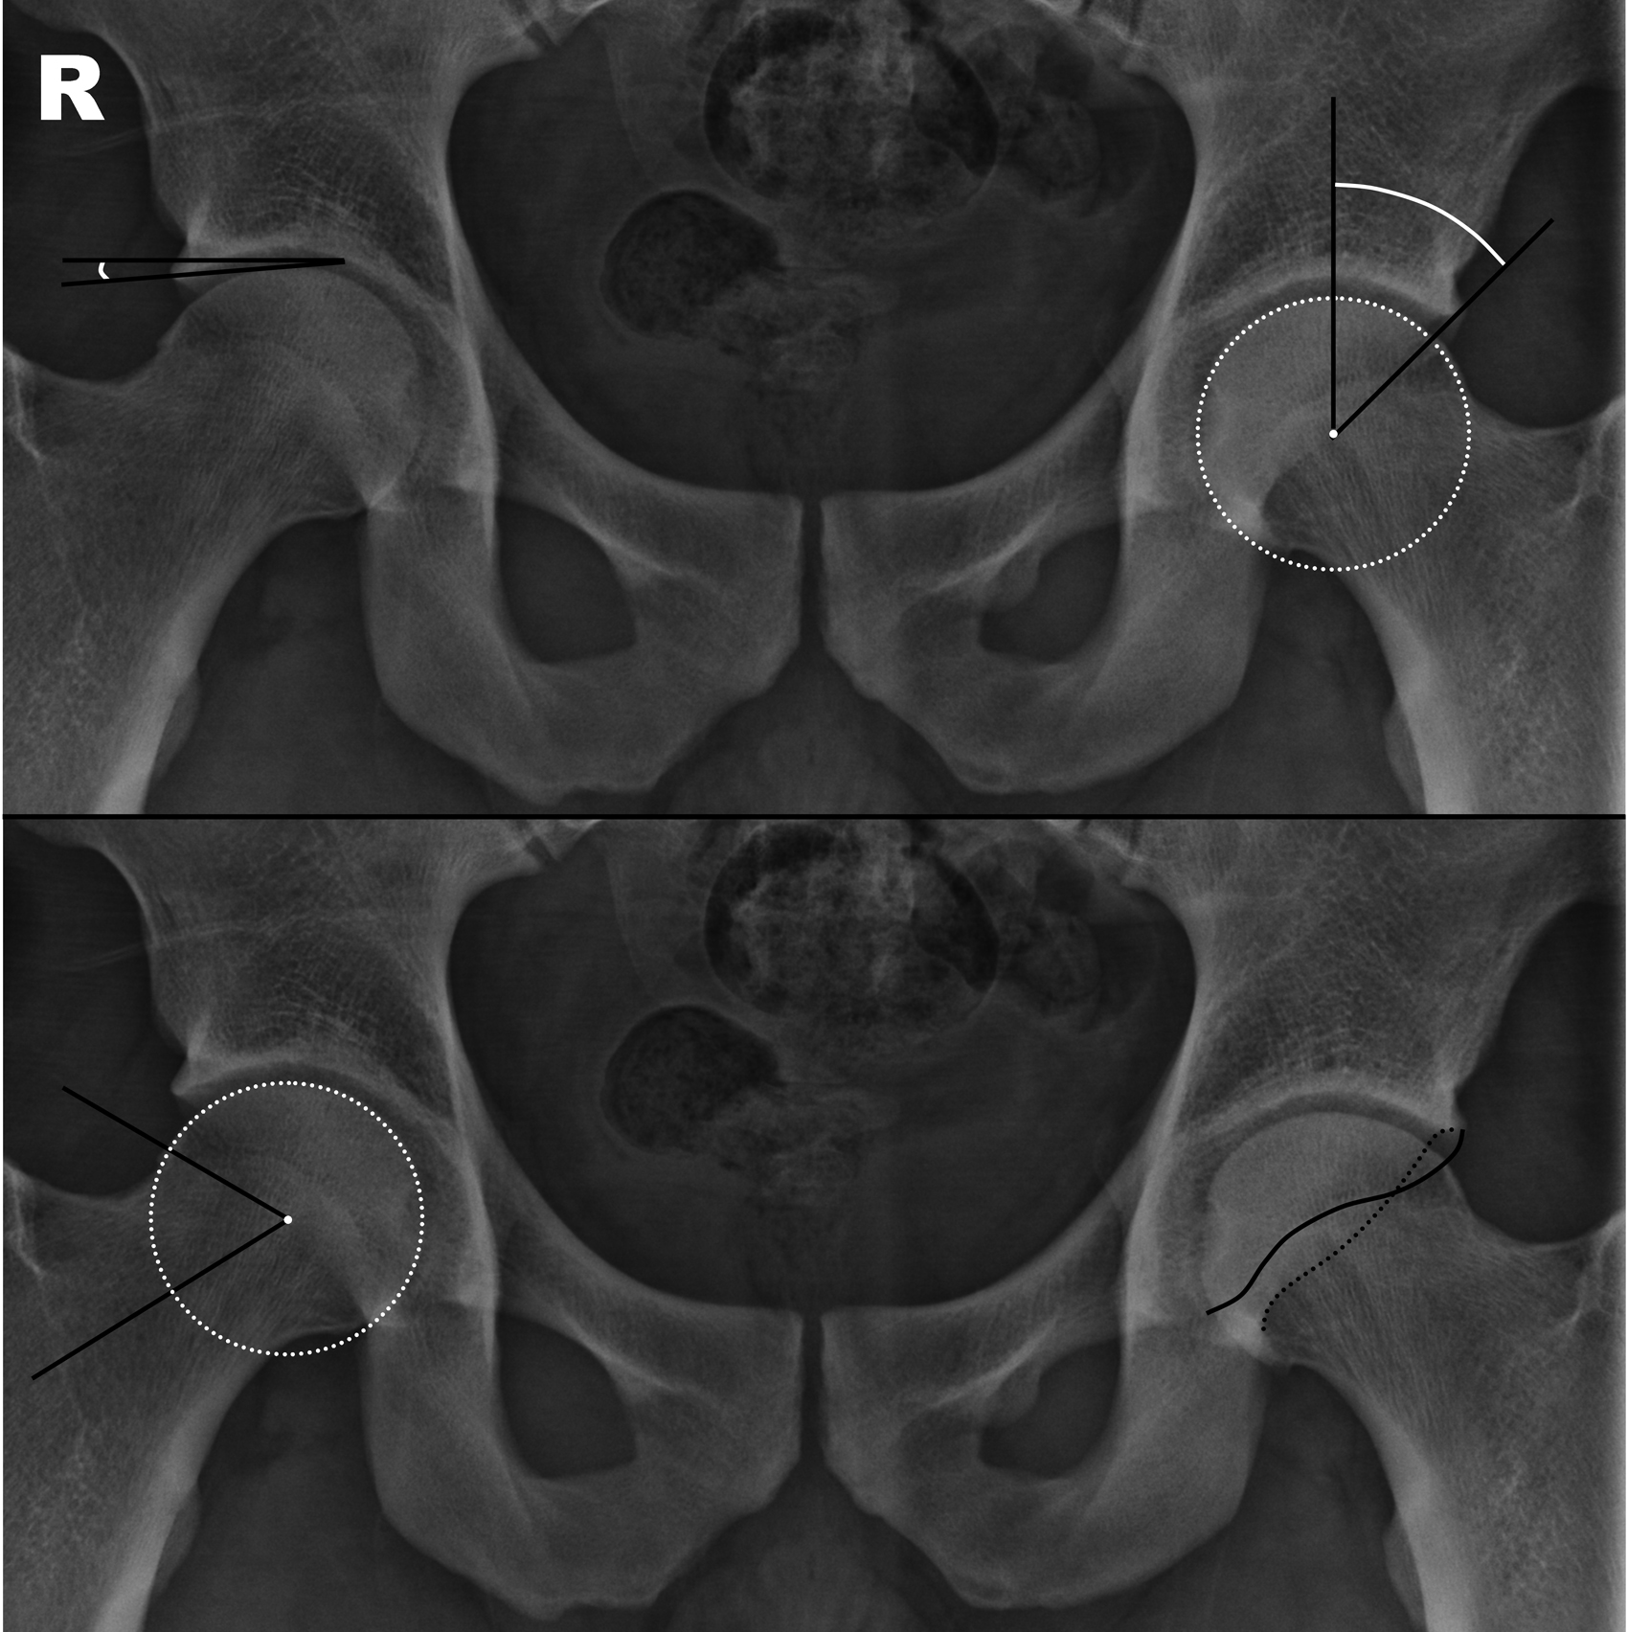
Center Edge Angle
(Normal 25-39, <15 = dysplasia)
Alpha angle
(Normal <50 deg)
Crossover sign

Slide 17
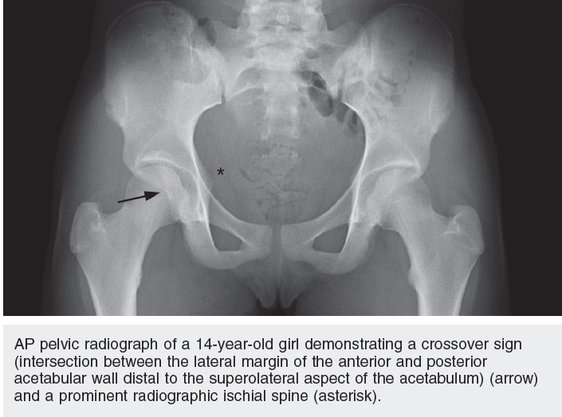

Slide 18
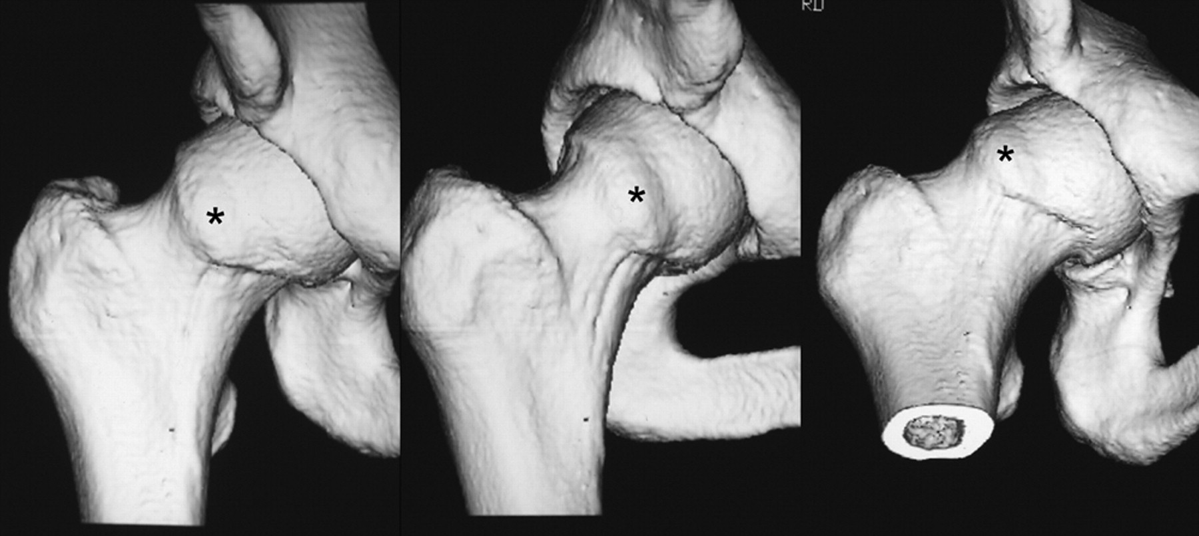
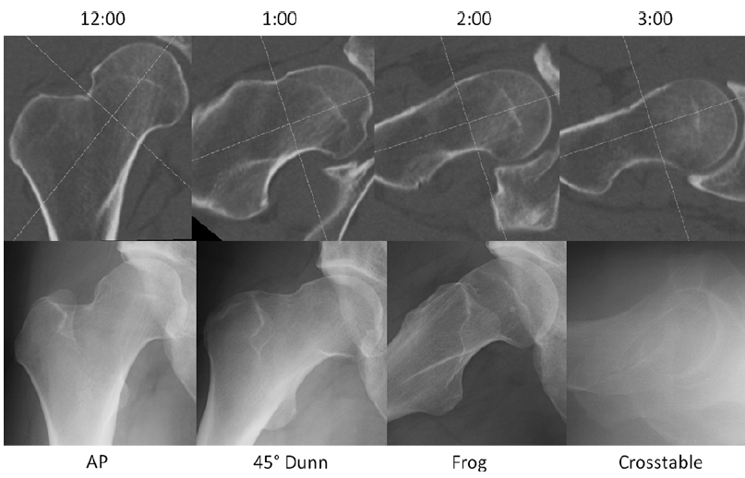
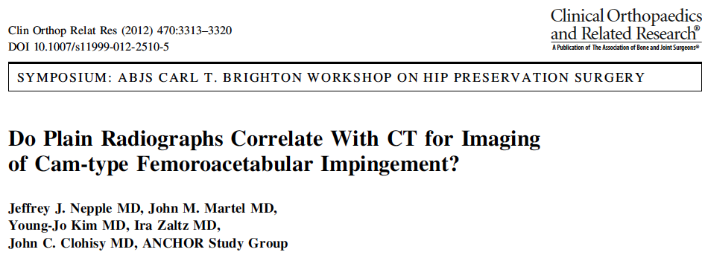
Standard Views
I recommend AP and Frog Leg views

Slide 19
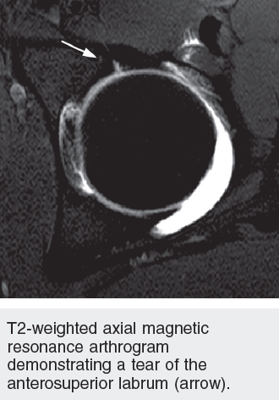

Slide 20
Hip Arthroscopy

Slide 21
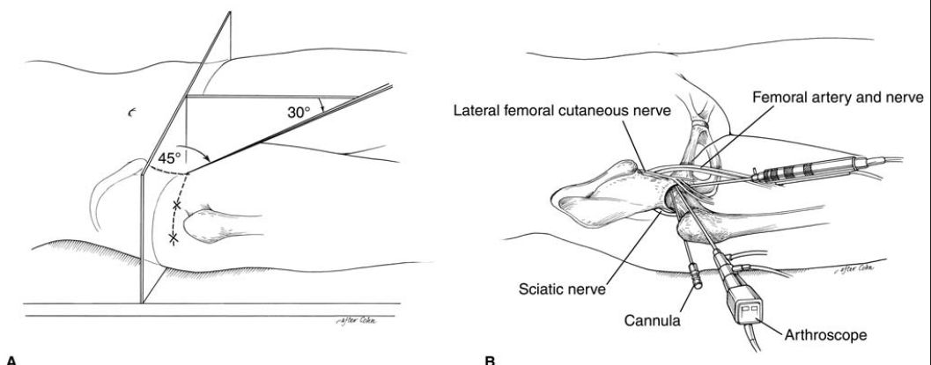

Slide 22
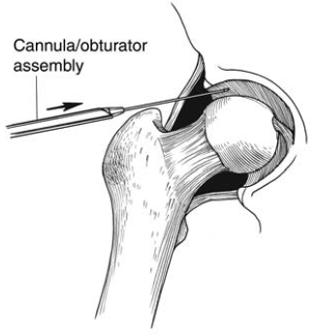

Slide 23
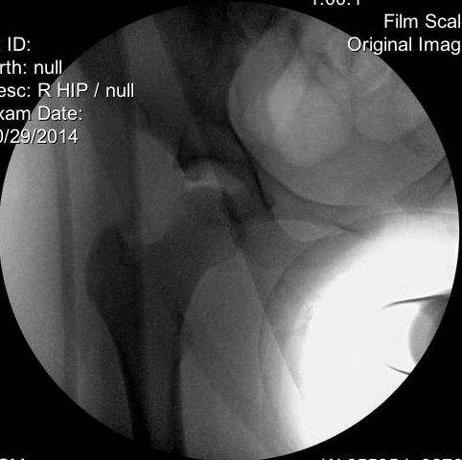
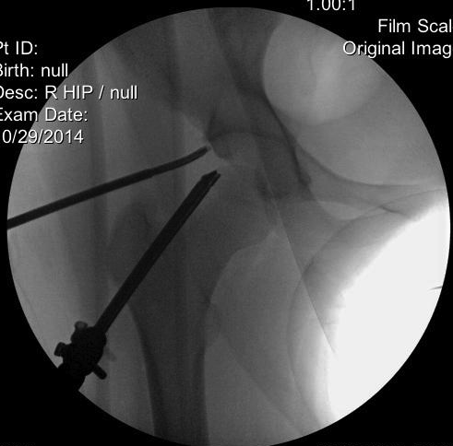

Slide 24
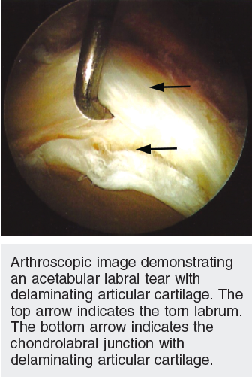

Slide 25
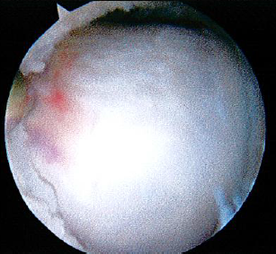
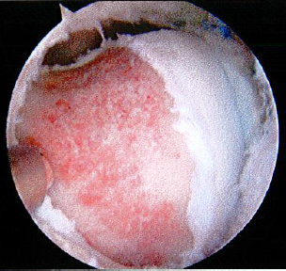
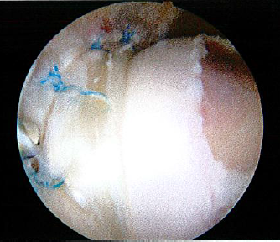
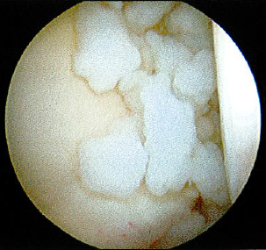
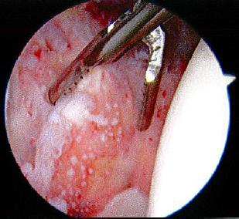

Slide 26
Abductor Tears
The Rotator Cuff of the Hip
Coaches, Active Parents, Teachers, and other active adults (typically >50s)

Slide 27
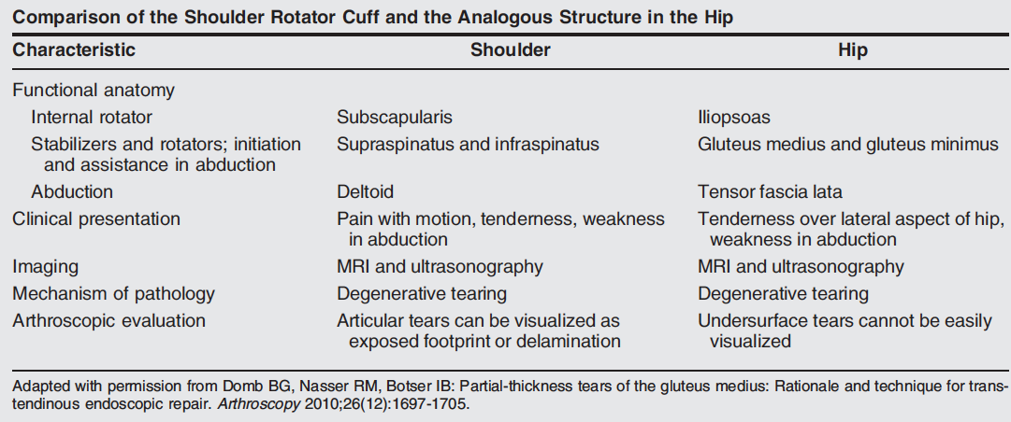

Slide 28
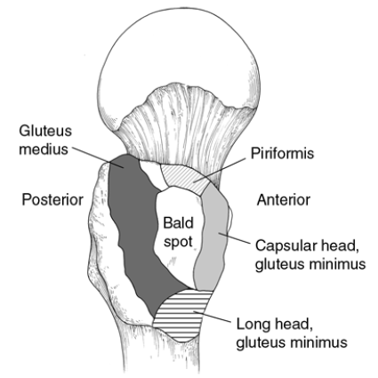
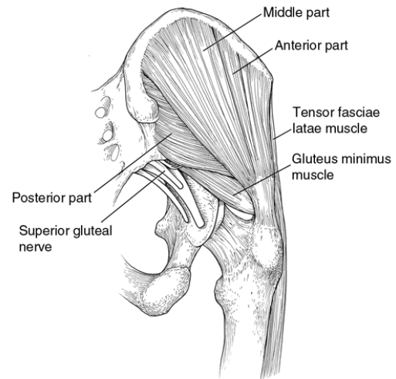
Abductor Anatomy

Slide 29
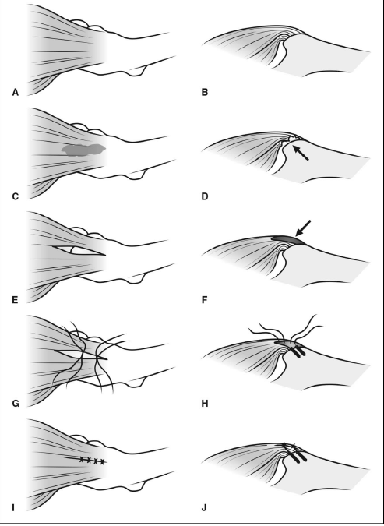

Slide 30
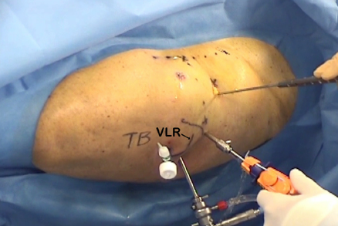
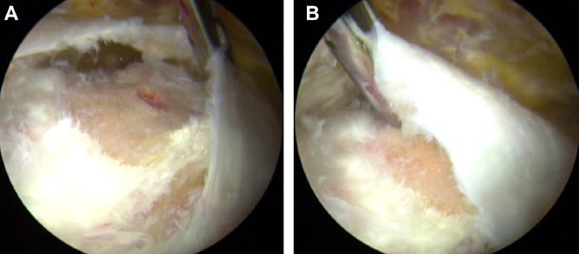
Abductor repair surgery

Slide 31
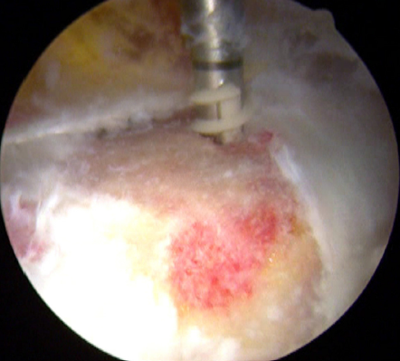
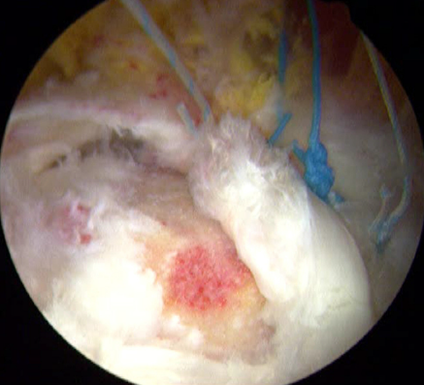

Slide 32
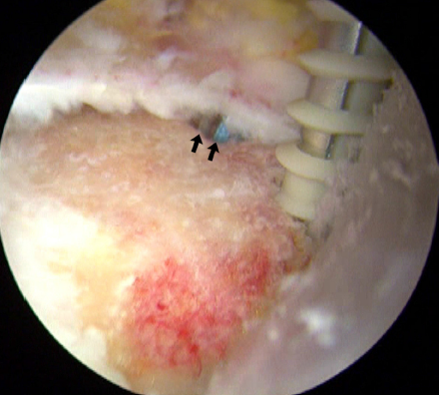
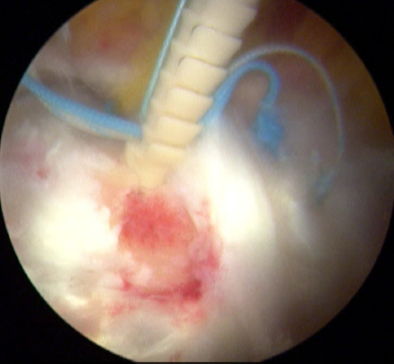

Slide 33
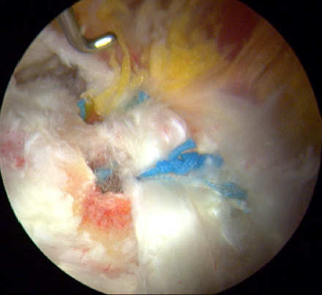

Slide 34
Where is the evidence?

Slide 35
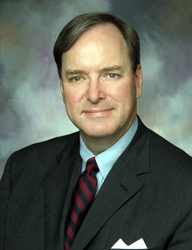

Slide 36
Prevention

Slide 37
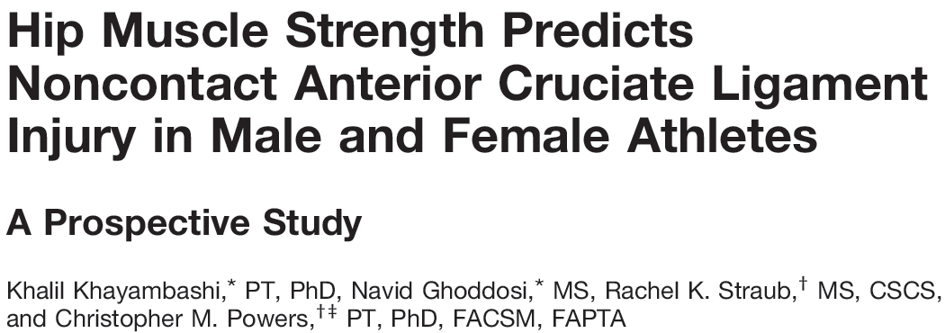
The hip dictates knee landing mechanics and rotational forces
Weak hip external rotation increased odds of ACL injury 23%
Weak abduction increased odds of ACL injury 12%

Slide 38
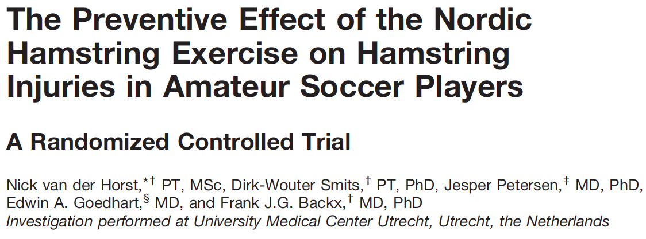
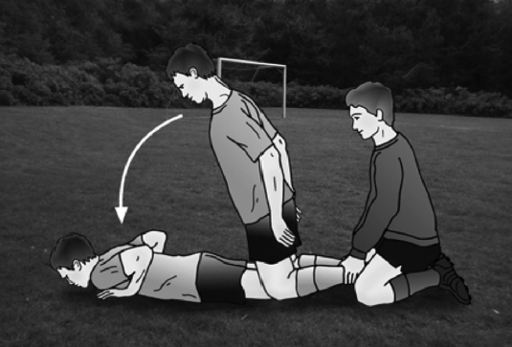
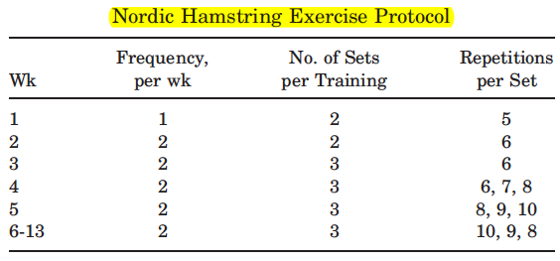
72% reduction in hamstring injuries during season vs control
579 athletes

Slide 39
Take-Home Points
Student athlete with anterior groin pain, clicking/catching like knee meniscus
Think Hip Labral Tear
Reduced hip ROM (especially decreased internal rotation) in young athlete
Think FAI
If your doctor orders an MRI, encourage marcaine arthrogram study with traction
Best sensitivity for labral tear, and diagnostic for intraarticular pain origin
Refer to a hip arthroscopist if clinical concern for FAI/labral tear, verified intra-articular pathology, or failure to improve with several months of activity modification/therapy
In patients >50 yo with recalcitrant “trochanteric bursitis,” consider abductor tear and referral to hip arthroscopist

Slide 40
Ian Rice MD
Contact Info
Philosophy
513-346-1599, or 513-346-1500
www.facebook.com/cincysportssurgeon
Treating every patient with the compassion and attention to detail I would provide my own family
Athletes of all ages and skill deserve the same professional-level care received by the world’s best athletes
I value accessibility and availability to both patients and colleagues, and believe the best outcomes result from a team-based approach to care

Slide 41
Office Locations
Contact my assistant Dave Ahouse MA ATC
directly at 513-346-1599
Office hours 5 days weekly including Saturday morning!
Same day or next day appointment
Rookwood
Clifton Group Health
4030 Smith Road, Suite 350 Cincinnati, OH 45209 Phone: 513 346 1500 Fax: 513 872 7826
West Chester (Discovery Drive)
7798 Discovery Drive, Suite A West Chester, OH 45069
379 Dixmyth Avenue Cincinnati, OH 45220
Surgery Locations at:
Bethesda Surgery Center
Evendale Hospital
Bethesda North Hospital
Good Samaritan Hospital

Slide 42
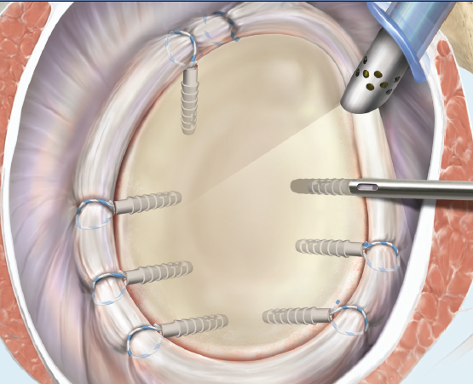
Specialties
Hip: Hip Labral repair, FAI surgery, Arthroscopic Hip Abductor Repair
NEW to
Sorry! Not hip replacement
Shoulder: Rotator Cuff Repair, Labral Repair, Subpectoral Biceps Tenodesis, Shoulder Stabilization
Knee: Anatomic ACL Reconstruction, All-Inside Meniscus Repair, Cartilage Repair and Restoration, Patella Stabilization with MPFL Reconstruction
Elbow: Elbow Arthroscopy, UCL Reconstruction (Tommy John Procedure), Distal Biceps Repair

Slide 43
Thank You

